Slide 1

PhD Application
Applicant: Haoran Hu
Master’s Major: Transportation Engineering

Slide 2

Personal Introduction
Personal Information
Name: Haoran Hu
Gender: Male
Nationality: Chinese
Supervisor: Professor Yanjun Wang
Skills: Python, Matlab, C++, Latex, ……
IELTS: 7.0
Education
Sep. 2018 – Jun. 2022
Civil Aviation University of China
Bachelor of Transportation
Sep. 2022 – Apr. 2025
Nanjing University of Aeronautics and Astronautics
Master of Transportation Engineering

Slide 3
目录/
CONTENTS
01
Master’s Research Introduction
02
Tactical Slot Optimization for AN
03
Integrated Optimization for AN
04
Strategic Slot Allocation for AN

Slide 4
01
Master’s Research Introduction

Slide 5
Research on tactical flight schedule robust optimizing for an nation-wide airport network & Solving algorithm development for large-scale stochastic programming
Haoran Hu
College of Civil Aviation
Nanjing University of Aeronautics and Astronautics

Slide 6
Master’s Research Introduction: Research Articles
Main Publications
Jianzhong, Yan. Haoran Hu, Yanjun Wang, et al. “Robust pre-departure scheduling for a nation-wide air traffic flow management.” Chinese Journal of Aeronautics. (JCR:Q1, Co-First Author, 2024, Accept)
Haoran Hu, Yanjun Wang. “A neighborhood search algorithm with dynamic search criteria for integrated optimization of air traffic scheduling and operations.” Computers & Industrial Engineering (JCR:Q1, First Author, 2025, Under Revision)
Haoran Hu, Yanjun Wang, et al. “An Algorithm for Slot Allocation in Airport Networks Based on Reinforcement Learning and Neighborhood Search.” Journal of Transportation Engineering and Information (T1, In Chinese) ( First Author, 2024, Accept)

Slide 7
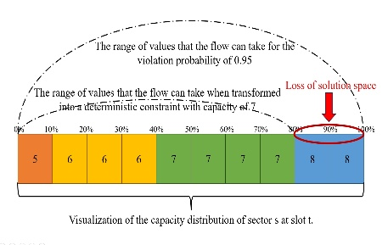
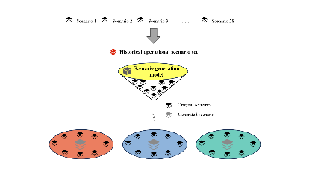
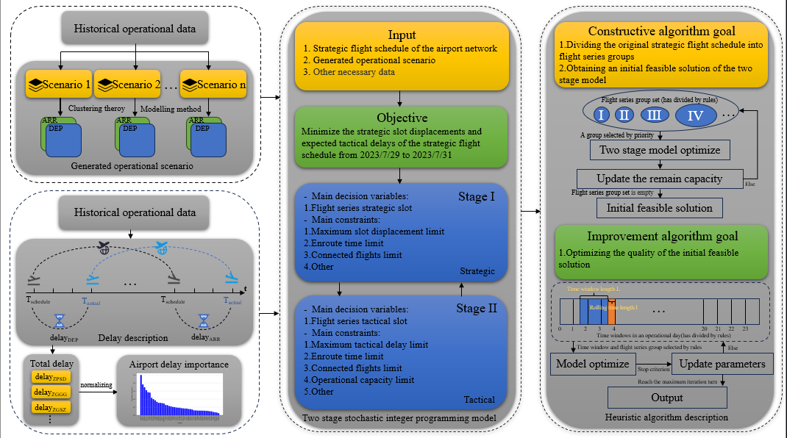
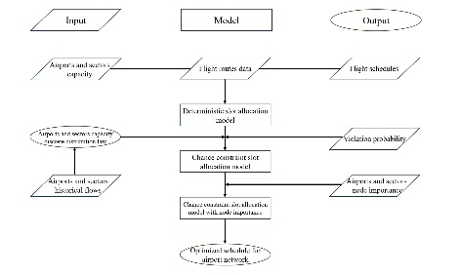
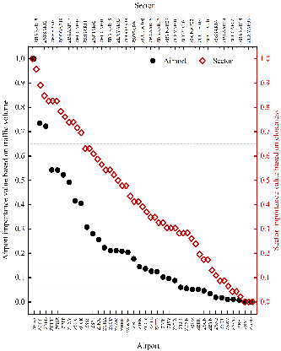
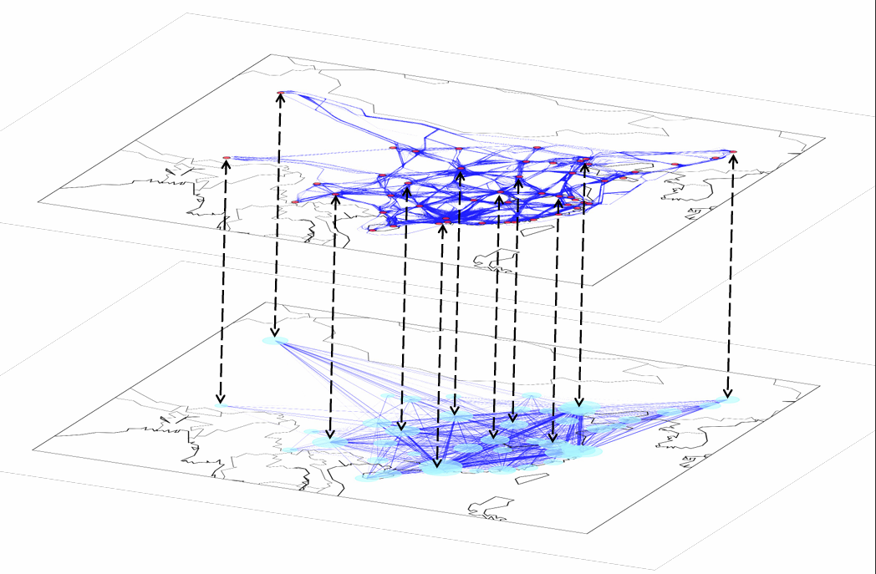
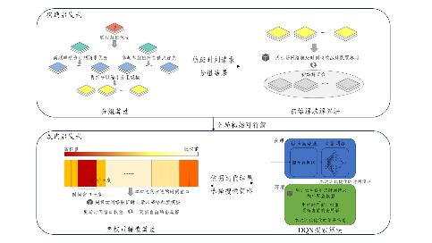
Master’s Research Introduction: Contributions
Model aspect
Algorithm aspect
A tactical pre-departure sequencing model ICCM-NI for obtaining a high quality tactical flight schedule considering capacity uncertainty and node importance
An efficient solving algorithm NS-DSC for multi-day two-stage stochastic integer model in optimizing strategic flight schedule
P2
P1
Model framework & Capacity uncertainty:
Two-stage model and algorithm framework:
Contributions
P3
An efficient intelligent solving algorithm NS-DQN for multi-day slot allocation model in obtaining strategic flight schedule
Node importance:
Algorithm framework:

Slide 8
02
Tactical Slot Optimization for AN

Slide 9
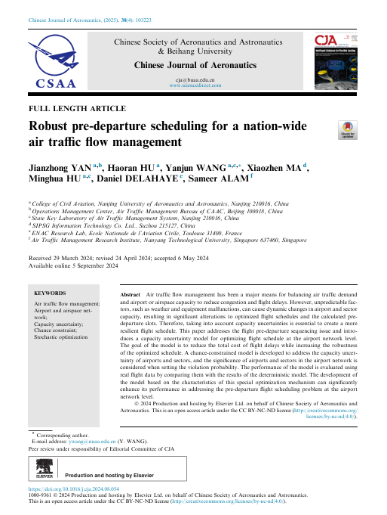

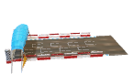



Tactical Slot Optimization for AN: Overview
①Application Scenario:
④Experiment Design:
Tactical stage
Violation probability of CC with NI
Flight schedule of Mainland China in 2018.8.1 9:00-12:00
DEP-Flight sequence
Node Importance
(NI)
Individual CC reformulation
Individual Chance-Constrained Model
(ICCM)
②Practical Problems:
③Technology
Roadmap:
Flight schedule
⑤Conclusion:
High robustness
Low delay cost
ICCM
ICCM-NI
Under tactical capacity uncertainty
Overview of Robust pre-departure scheduling for a nation-wide air traffic flow management

Slide 10
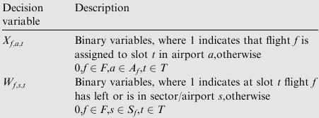
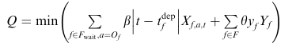
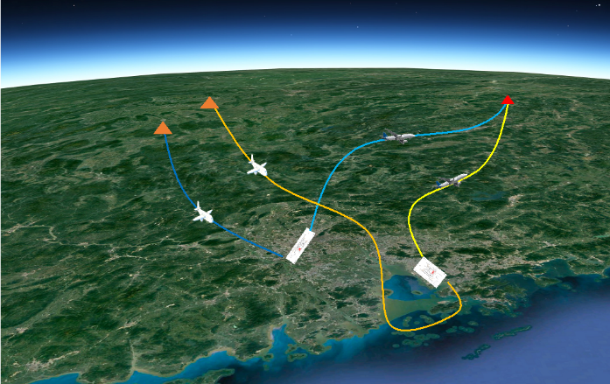
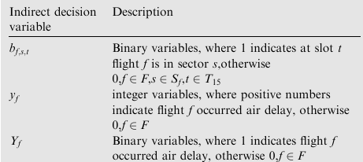
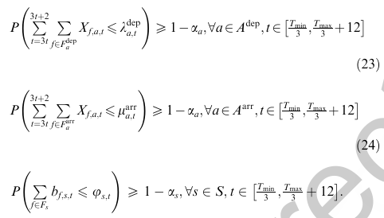
Tactical Slot Optimization for AN: Model
Optimize the tactical pre-departure sequencing for an airport network
Obtain flight schedule with higher robustness and lower delay cost
Decision variables
Objective function
Constraints
(1)Flight operational constraints
(2)Chance constraints considering operational capacity uncertainty of airports and sectors

Slide 11
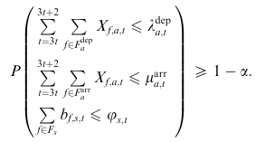
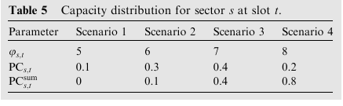
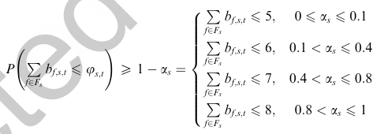
Tactical Slot Optimization for AN: Reformulation
Joint chance constraints
Violation probability
Bonferroni conservative approximation
Individual chance constraints
Deterministic constraints
Operational capacity discrete distribution

Slide 12
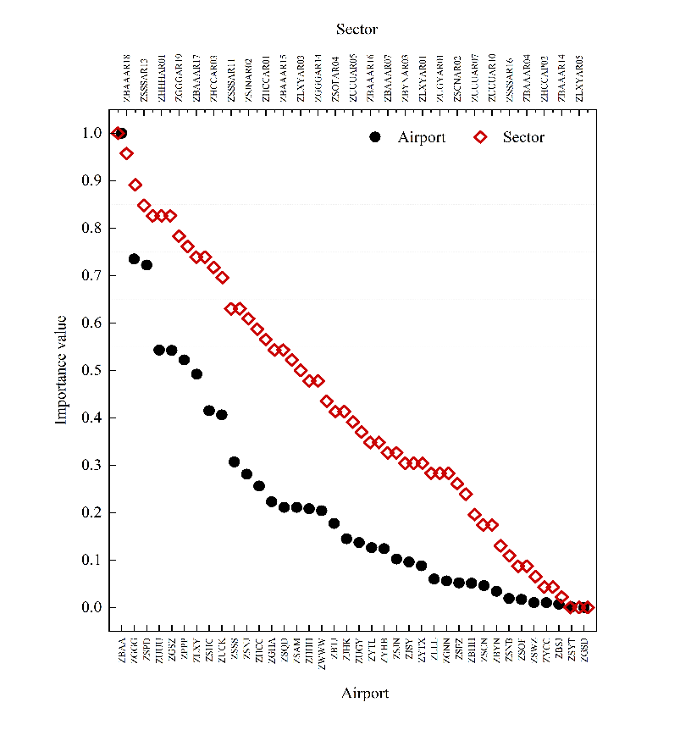

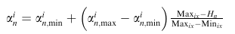
Tactical Slot Optimization for AN: Node Importance
- Consider node importance in violation probability setting:
The importance value of node n

Slide 13
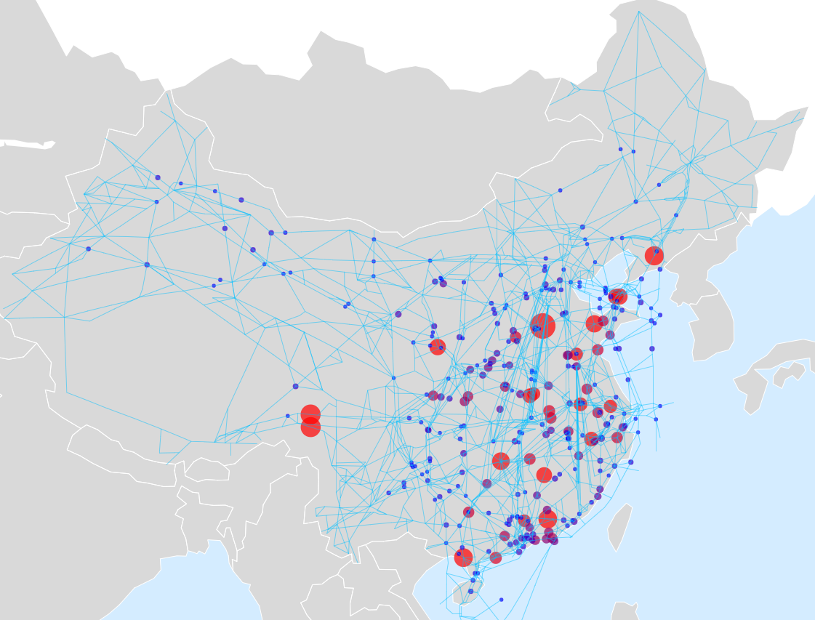
Tactical Slot Optimization for AN: Experimental Setup
The flight schedule from 9:00 a.m. to 12:00 a.m. on August 1, 2018 is used as input data for the models
Considering 55 airports and 38 congested sectors
During the period, there were 3435 flights
At 9:00 a.m., 1156 flights were in the air, while 2279 were still on the ground

Slide 14
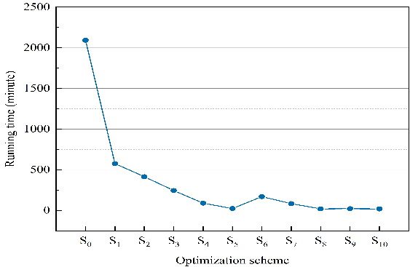
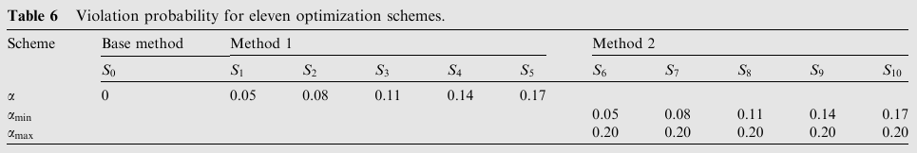
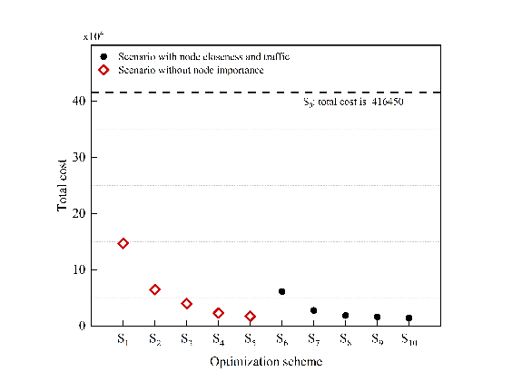
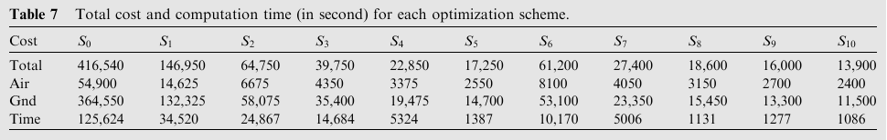
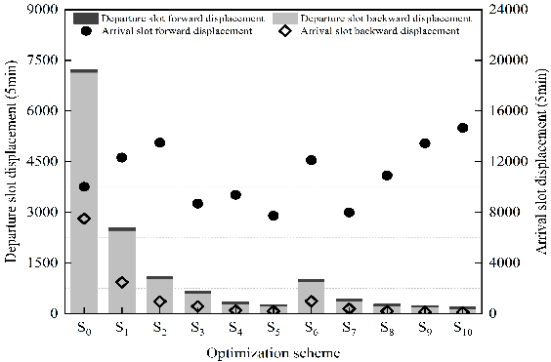
Tactical Slot Optimization for AN: Computational Results
1
Violation probability$α$ setting for each optimization schemes:
2
Gurobi
Objective cost and computation time for each optimization schemes:
3

Slide 15
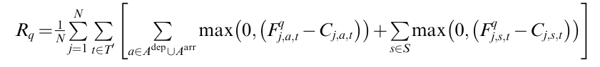
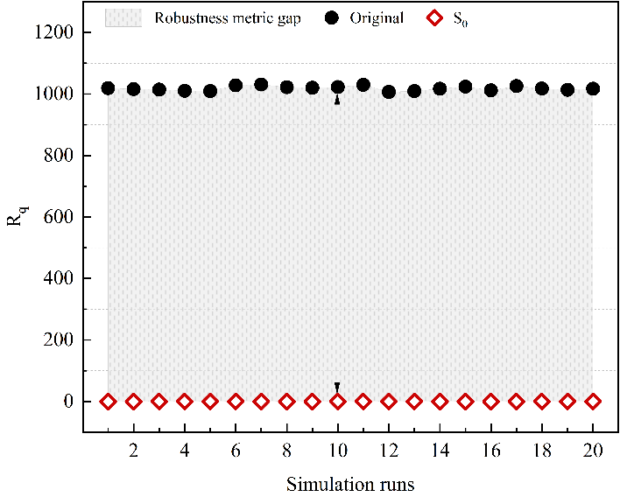
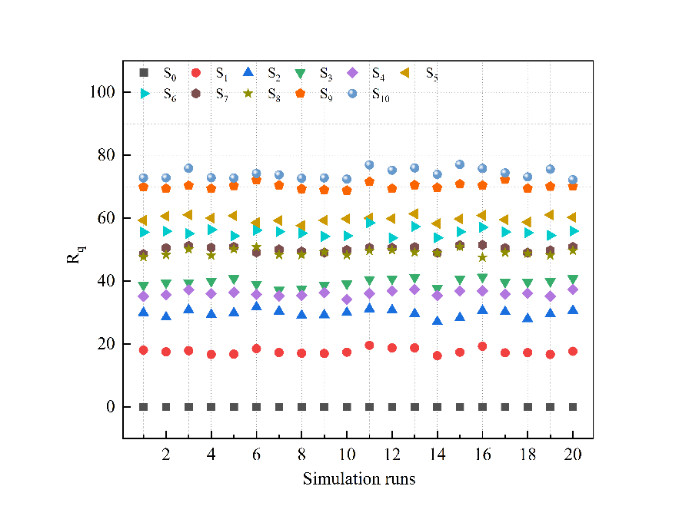
Tactical Slot Optimization for AN: Robustness Tests
Robustness measurement formula:
Simulation tests
Robustness measurement results:
1
2

Slide 16
Tactical Slot Optimization for AN: Summary & Conclusion
Problem: Tactical DEP-Flight sequenceing for an airport network
High flight delay in the tactical stage
Operational uncertainty
Conclusions
Better tactical flight schedule in need
Lower delay cost
Higher robustness
DM&ICCM
ICCM-NI
Methodologies
Chance-constrained programming
Chance constraints reformulation
Violation probability considering the node importance

Slide 17
03
Integrated Optimization for AN

Slide 18
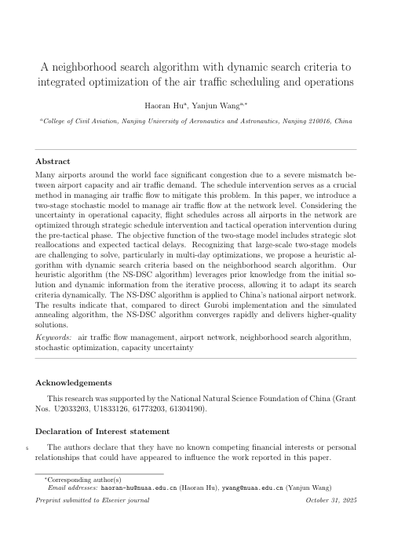

Integrated Optimization for AN: Overview
①Application Scenario:
④Experimental Design:
Pre-tactical stage
NS-DSC Algorithm
Flight schedule of Mainland China in 2023.7.29~2023.7.31
Flight schedule optimize
Scenario Generation Model(SGM)
Sensitivity analysis
Multi-Day Two-Stage Model
②Practical Problems:
③Technology Roadmap:
Two-Stage
Integrated optimize
⑤Conclusion:
Large-scale stochastic IP model
Under operational capacity uncertainty
SA/Gurobi
NS-DSC
Overview of A neighborhood search algorithm with dynamic search criteria to integrated optimization of the air traffic scheduling and operations

Slide 19
Integrated Optimization for AN: Why Two-stage Model?
Theoretical Aspect:
Two-stage model is commonly used to deal with sequential decision-making problem
Study of Wang and Jacquillat(2020) has proved that two-stage model is better in strategic slot schedule optimization than sequential model
Practical Aspect:
Strategic stage
Several months before operation
Based on uncertainty
Tactical stage
Each operational day
Based on certainty scenarios
Slot allocation
Ground delay
Here and Now
Wait and See
Optimized schedule
Operational slots
Slot displacements
Flight delays

Slide 20
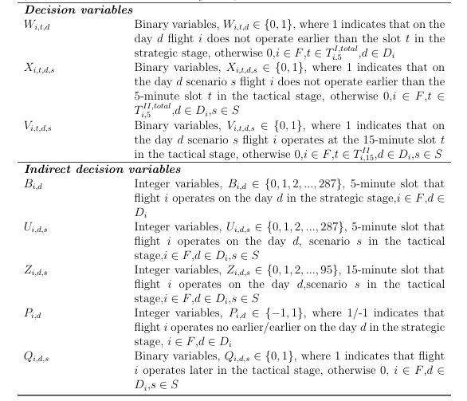
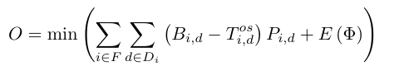
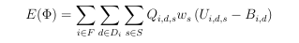
Integrated Optimization for AN: Two-stage Model
Optimize the strategic slot schedule for the airport network
Minimize the cost of strategic slot displacements and expected tactical delays
Decision variables
Objective function
Constraints
Minimize displacements and expected delays：
First stage:
Strategic scheduling constraints
Second stage:
Tactical operation constraints
capacity limitations
Optimize SA and TO simultaneously

Slide 21
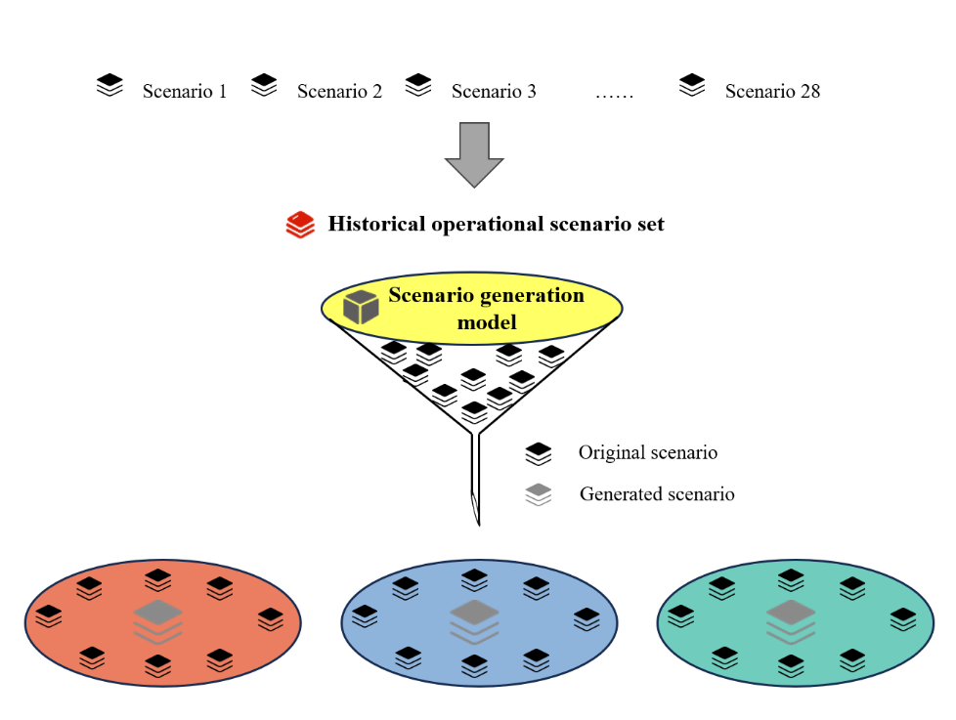
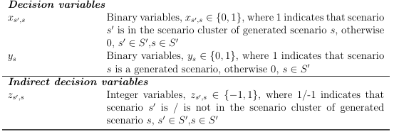

Integrated Optimization for AN: Scenario Generation Model
Decision variables
Objective function
Minimize the Manhadun distance among each historical operational scenario
Model Output
Operational capacity and corresponding probability in each operational scenario
The scenario generation model framework

Slide 22
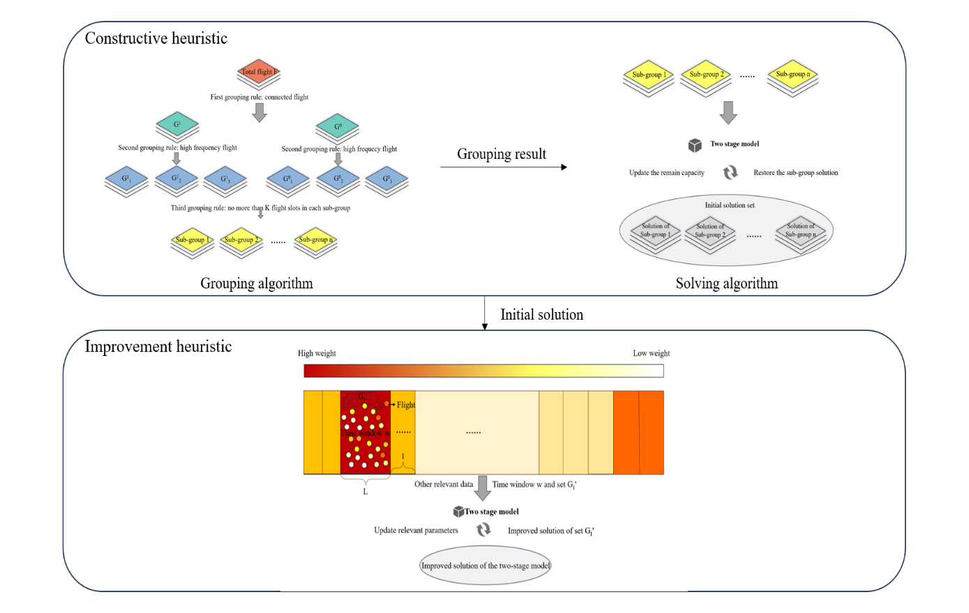
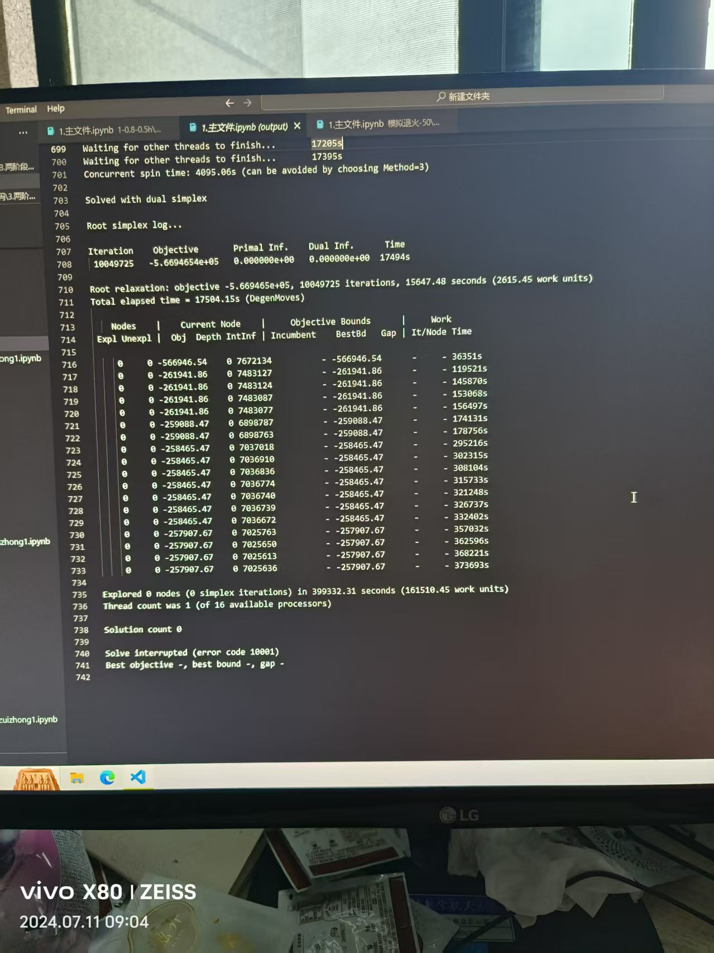
Integrated Optimization for AN: Solution Approaches
Directly solve with Gurobi:
NS-DSC Algorithm:
Gurobi solver is unable to obtain a global feasible solution within a reasonable computational time, and the lower bound of the two-stage model converges very slowly
To overcome this challenge, I develop a heuristic algorithm called NS-DSC

Slide 23
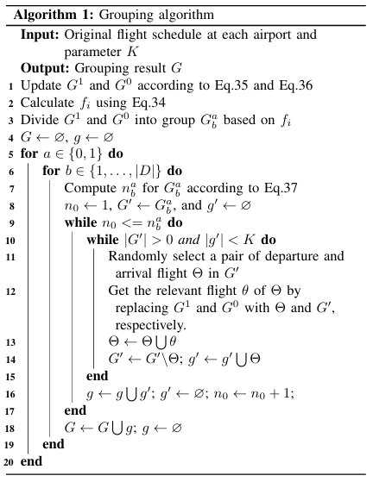
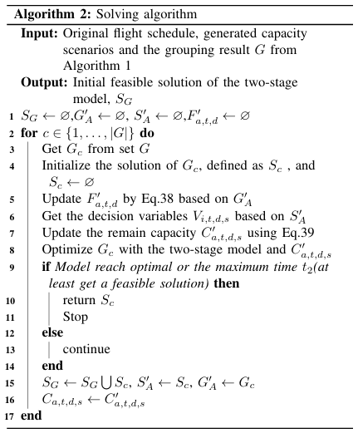
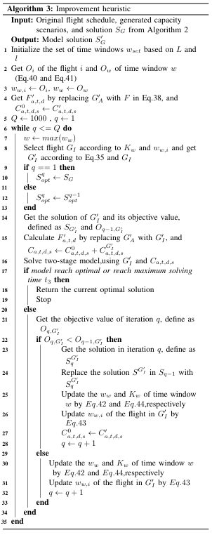
Integrated Optimization for AN: NS-DSC Algorithm
NS-DSC Pseudocode:

Slide 24
Integrated Optimization for AN: Experimental Setup
The flight schedule from 29 to 31 on July, 2023 is used as input data for the two-stage model
The experimental data mainly includes 51 major airports, each with an average daily flight volume exceeding 100
During this period, there were 41682 flights
The flight time of the aircraft along the routes can fluctuate by ±10%

Slide 25
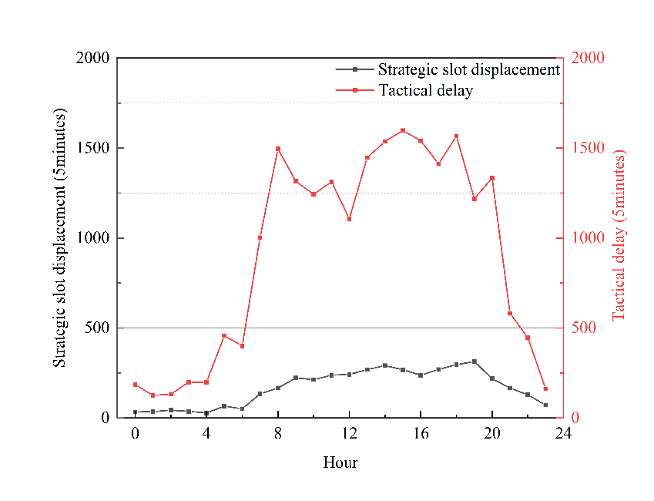
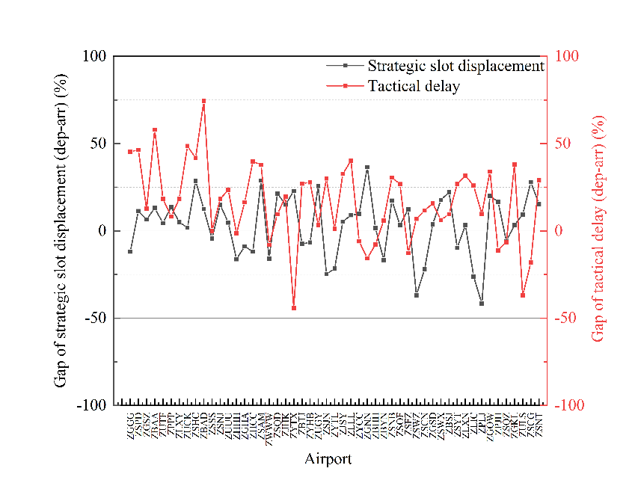
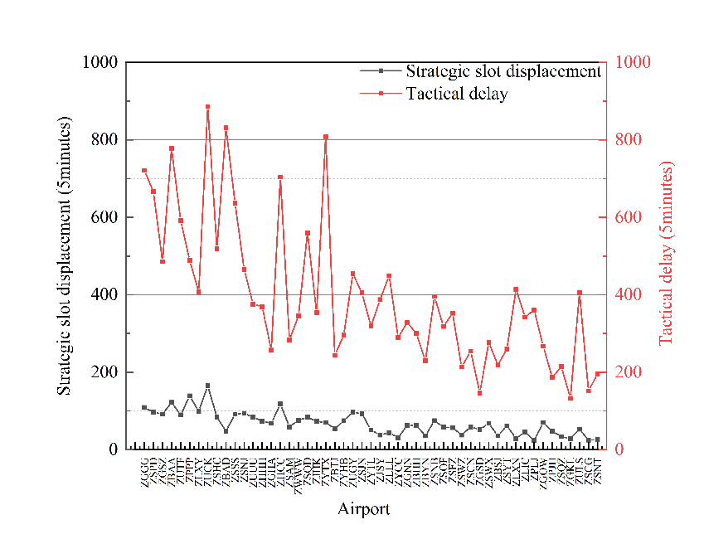
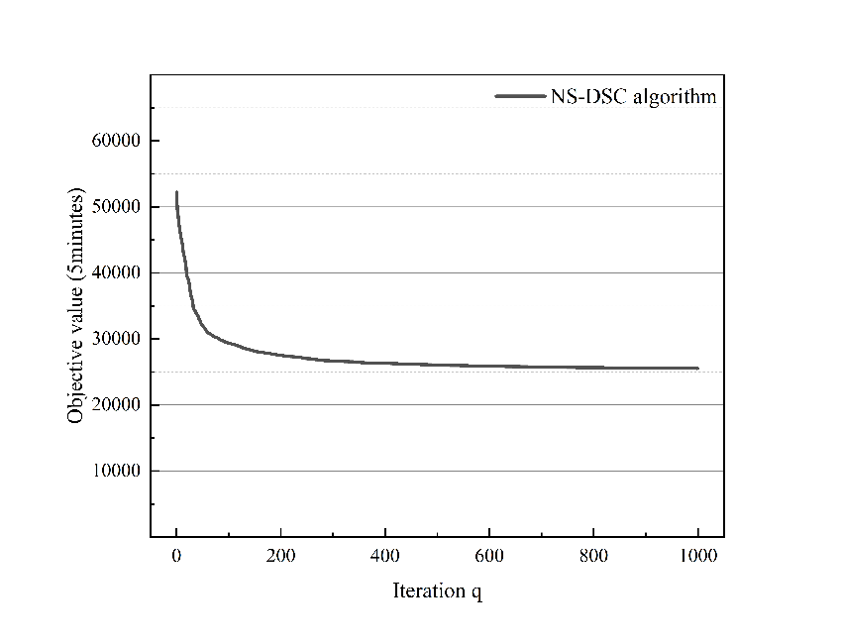
Integrated Optimization for AN: Computational Results
1.Temporal:
3.Dep/Arr:
2.Spatial:
4.NS-DSC Computational performance:

Slide 26
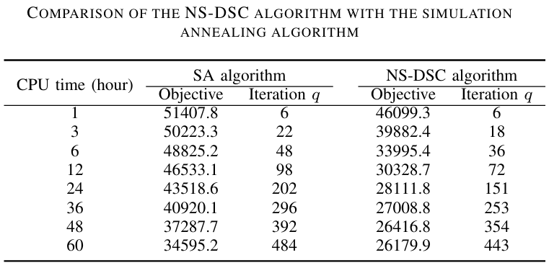
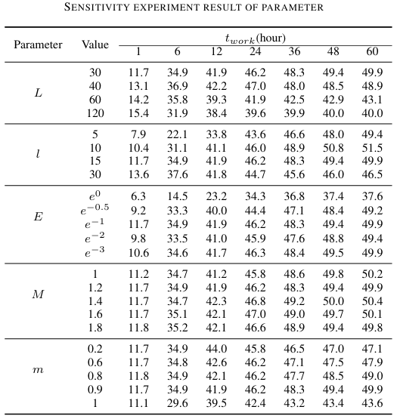
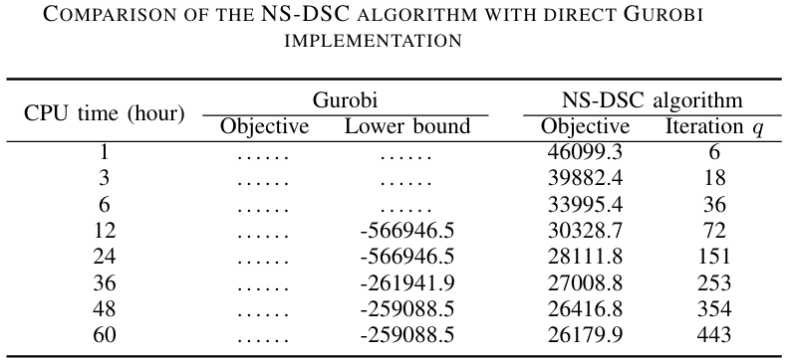
Integrated Optimization for AN: Algorithm Performance
Algorithm comparisons:
Sensitivity experiments:
1
3
2

Slide 27
Integrated Optimization for AN: Summary & Conclusion
Problem: Strategic flight schedule optimizing for an airport network in the pre-tactical stage
High flight delay in the tactical stage & Operational uncertainty
Solving approach of large-scale stochastic integer programming
Conclusions
Efficient solving algorithm in need
SA/Gurobi
NS-DSC
Methodologies
Two-stage multi-day stochastic integer programming
Tactical capacity scenario generation model
NS-DSC algorithm

Slide 28
04
Strategic Slot Allocation for AN

Slide 29
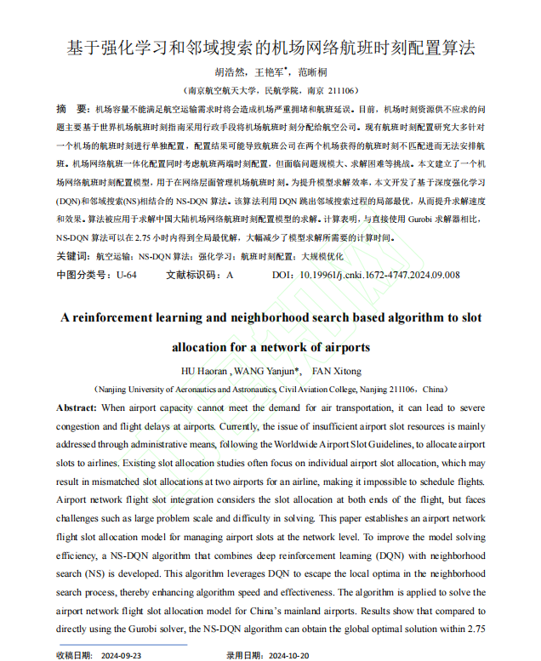
Strategic Slot Allocation for AN: Overview
①Application Scenario:
④Experimental Design:
Strategic stage
Deep Q-learning Net
Flight slot request of Mainland China in 2023.7.24~2023.7.30
Flight slot allocation
NS-DSC Algorithm
Multi-Day Slot Allocation Model
②Practical Problems:
③Technology Roadmap:
Initial slot allocation
⑤Conclusion:
Multi-Day
Large-scale IP model
Gurobi
NS-DQN
Overview of A reinforcement learning and neighborhood search based algorithm to slot allocation for a network of airports

Slide 30
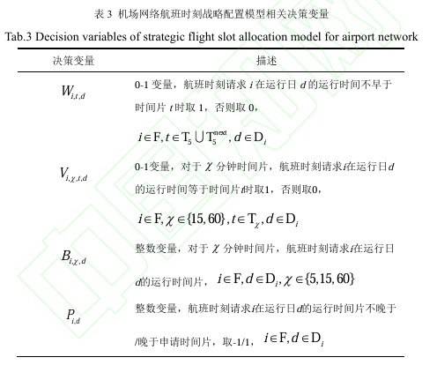
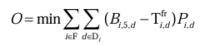
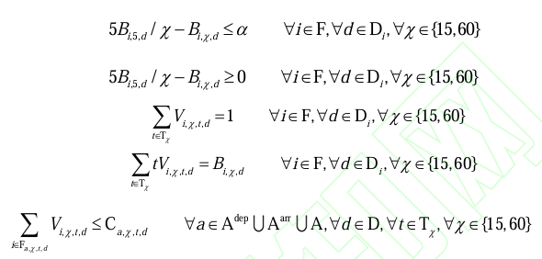
Strategic Slot Allocation for AN: Model
Allocate the flight slots for the airport network in the strategic stage
Obtain strategic flight schedule with lowest slot displacements
Decision variables
Objective function
Constraints
(1)Flight operational constraints
(2)Declared capacity constraints

Slide 31




Strategic Slot Allocation for AN: NS-DQN Algorithm
NS-DQN Algorithm:
NS-DQN Pseudocode:
Reward
Experience
Q Net
State
Action
Next state
Current slot displacement situation
Next time window to be optimized
Next slot displacement situation
NS-DQN algorithm framework
DQN module

Slide 32
Strategic Slot Allocation for AN: Experimental Setup
The flight schedule from 24 to 30 on July, 2023 is used as input data for the strategic slot allocation model
The experimental data mainly includes 51 major airports, each with an average daily flight volume exceeding 100
During this period, there were 91960 flights
The maximum strategic time displacement for all flight slot requests is restricted to 15 minutes

Slide 33




Strategic Slot Allocation for AN: Computational Results
1.Temporal:
3.NS-DQN Computational performance:
2.Spatial:
4.Algorithm comparison:

Slide 34
Strategic Slot Allocation for AN: Summary & Conclusion
Problem: Strategic flight slot allocation for an airport network in the strategic stage
Solving approach of multi-day slot allocation integer programming
Conclusions
Efficient solving algorithm in need
Gurobi
NS-DQN
Methodologies
Multi-day strategic slot allocation integer programming
NS-DQN algorithm

Slide 35
Q & A

